Slide 1
Notes:
https://teams.microsoft.com/l/file/dafa2ffe-d413-43bc-bf21-d80244c1e56b?tenantId=0054a3ea-b394-418b-ad1a-174138231fd6&fileType=pptx&objectUrl=https%3A%2F%2Ffredhutch-my.sharepoint.com%2Fpersonal%2Fjbielas_fredhutch_org%2FDocuments%2FMicrosoft%20Teams%20Chat%20Files%2FVisium%200325.pptx&baseUrl=https%3A%2F%2Ffredhutch-my.sharepoint.com%2Fpersonal%2Fjbielas_fredhutch_org%2F&serviceName=p2p&threadId=19:meeting_MjViZDdjM2EtZTMxYy00N2JiLWFhMWItNzhlNDQ3YmFiODVm@thread.v2&messageId=1586543637442
https://teams.microsoft.com/l/file/f6f89303-16ec-4312-95de-435adf4c126c?tenantId=0054a3ea-b394-418b-ad1a-174138231fd6&fileType=xlsx&objectUrl=https%3A%2F%2Ffredhutch-my.sharepoint.com%2Fpersonal%2Fezhao_fredhutch_org%2FDocuments%2FMicrosoft%20Teams%20Chat%20Files%2FVisium%20slide%20and%20sample%20info.xlsx&baseUrl=https%3A%2F%2Ffredhutch-my.sharepoint.com%2Fpersonal%2Fezhao_fredhutch_org%2F&serviceName=p2p&threadId=19:meeting_MjViZDdjM2EtZTMxYy00N2JiLWFhMWItNzhlNDQ3YmFiODVm@thread.v2&messageId=1586543446499
https://teams.microsoft.com/l/file/c66de27f-f460-4242-a38b-9bd400bda977?tenantId=0054a3ea-b394-418b-ad1a-174138231fd6&fileType=xlsx&objectUrl=https%3A%2F%2Ffredhutch-my.sharepoint.com%2Fpersonal%2Fjbielas_fredhutch_org%2FDocuments%2FMicrosoft%20Teams%20Chat%20Files%2FMCC_OCT_28Oct2019.xlsx&baseUrl=https%3A%2F%2Ffredhutch-my.sharepoint.com%2Fpersonal%2Fjbielas_fredhutch_org%2F&serviceName=p2p&threadId=19:meeting_MjViZDdjM2EtZTMxYy00N2JiLWFhMWItNzhlNDQ3YmFiODVm@thread.v2&messageId=1586543127292
Xing Ren
Edward Zhao

Slide 2
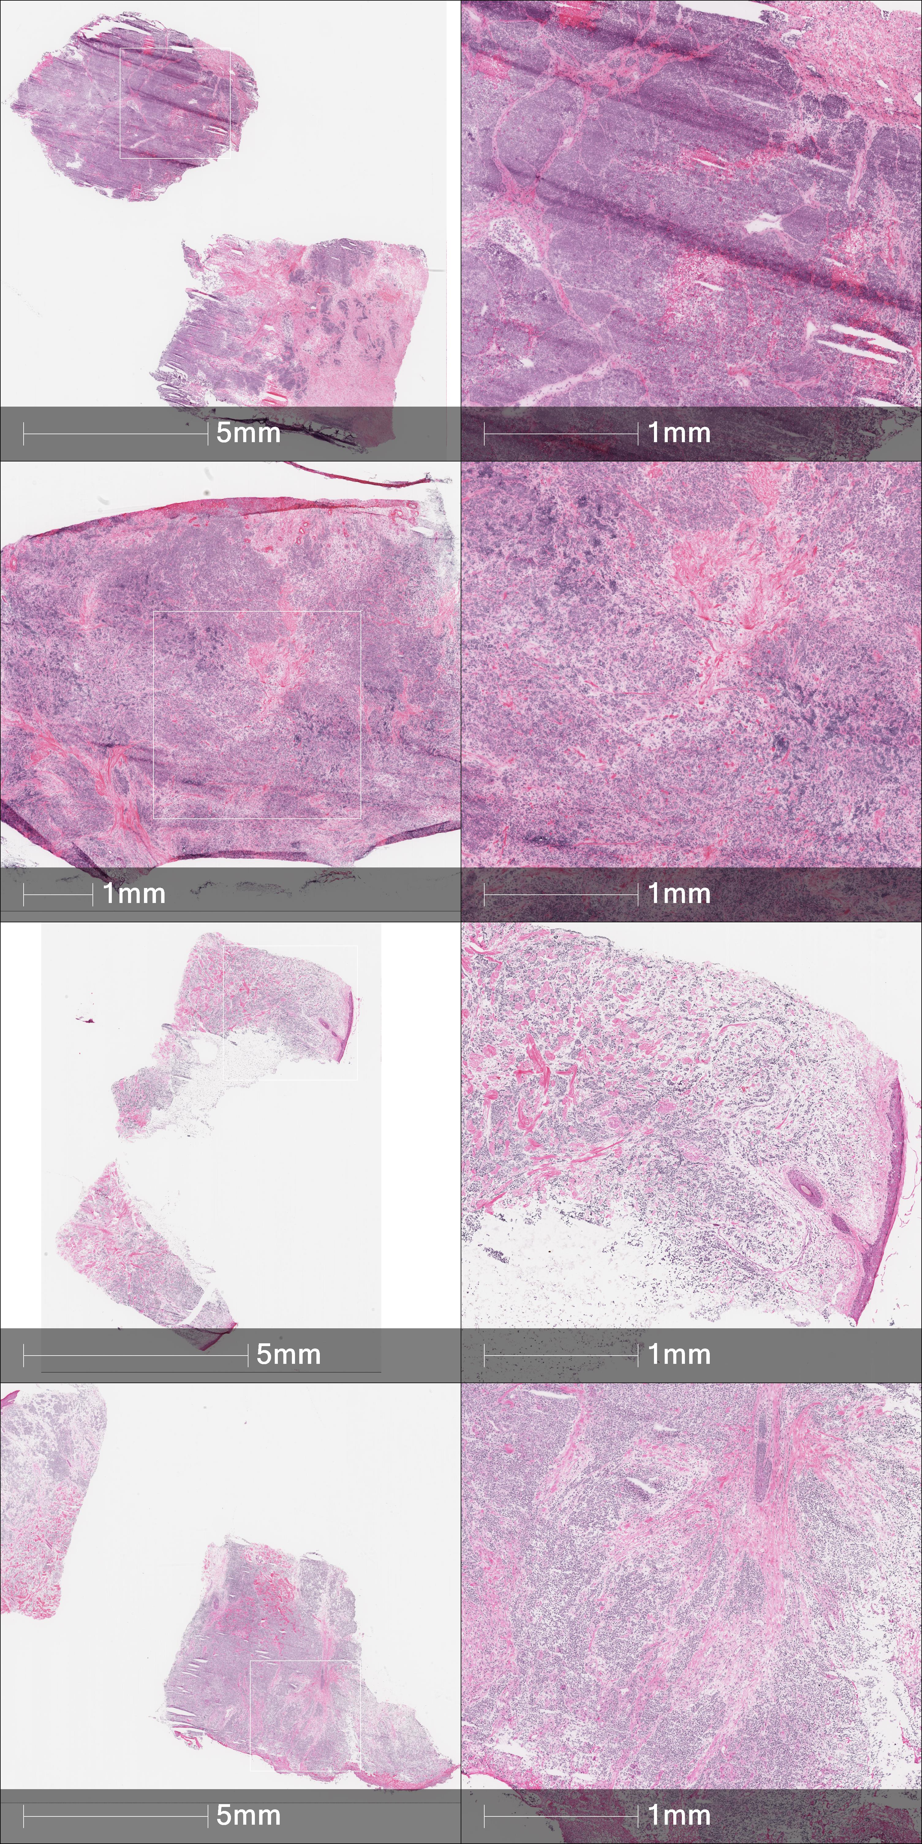
17A | W415 | fp12-005 | 285449 | Virus-Positive | Immune Desert
44D | W915 | fp12-046 | 285431 | No data | Immune Desert
17B | W981 | fp13-007 | 285427 | Virus-Positive | Immune Desert
17C | W1001 | fp13-008 | 285426 | Virus-Negative | Immune Desert

Slide 3
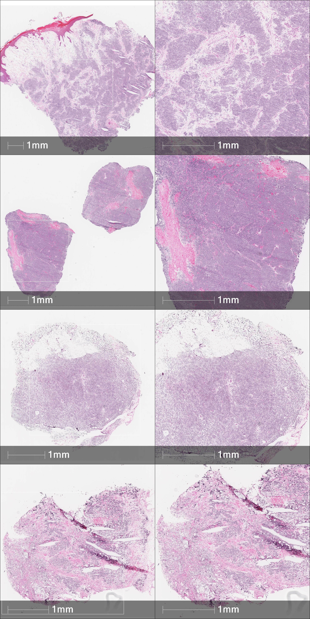
17D | Z1223 | fp16-015 | 285557 | Virus-Negative | Immune Desert
28A | W1044 | fp16-021 | 285569 | Virus-Positive | Immune Desert
44A | W420 | fp11-025 | 285446 | Virus-Positive | Immune Excluded
44B | W664 | fp11-037 | 285465 | Virus-Positive | Immune Excluded

Slide 4
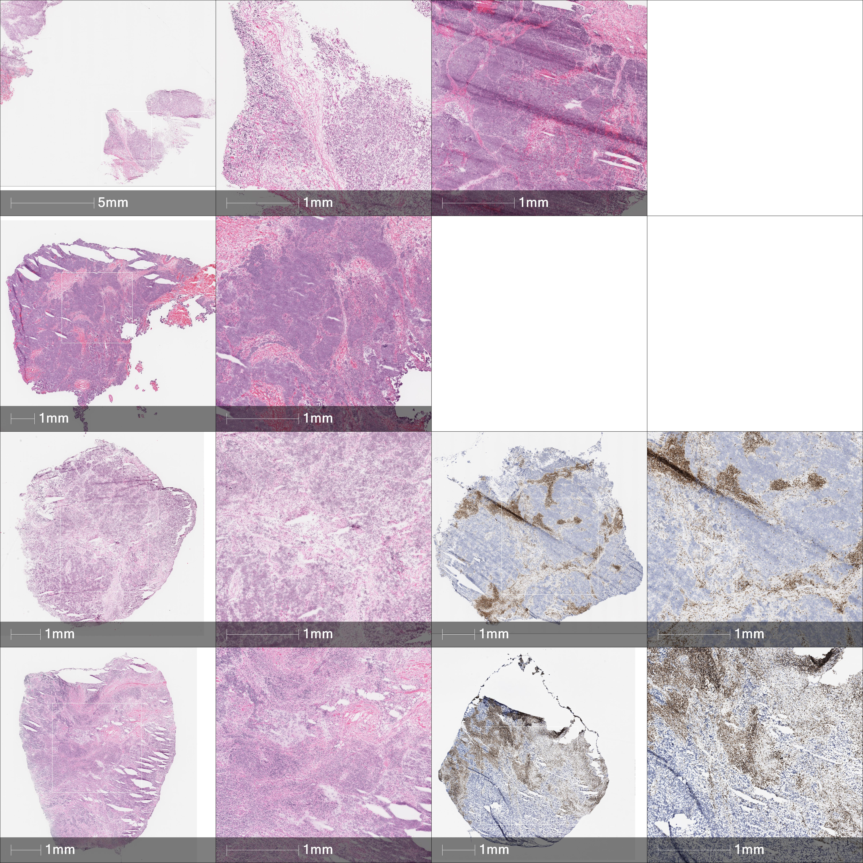
28B | W861 | Fp12-035 | 285423 | Virus-Positive | Immune Excluded
28D | Z1059 | fp14-001 | 285586 | Virus-Positive | Immune Excluded
44C | Z1233 | fp16-009 | 285574 | Virus-Positive | Immune Excluded
28C | Z1233 | fp16-007 | 285573 | Virus-Positive | Immune infiltrated

